Slide 1

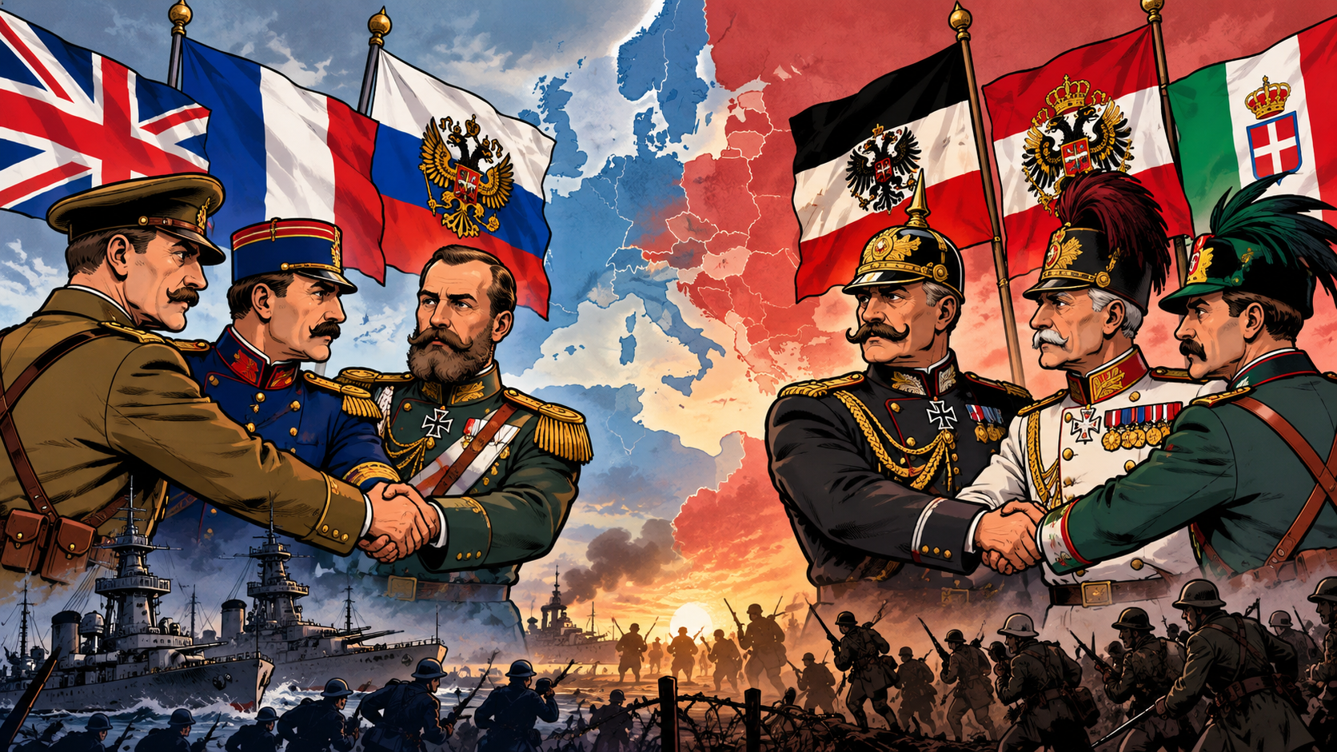
Title: Friends and Foes - The Alliance System
LO: How did the formation of the Triple Entente and Triple Alliance increase the likelihood of war?
Title: Friends and Foes - The Alliance System
Key Enquiry Question: What were the causes of WW1, and how did different factors contribute to the outbreak of the conflict?
1. What is the difference between a colony and an empire?
2. How could having an empire make a country more powerful?
3. How could an empire change the culture of the countries it rules? Can you give an example?

Slide 2
Title: Friends and Foes - The Alliance System
LO: How did the formation of the Triple Entente and Triple Alliance increase the likelihood of war?
Title: The Long Fuse - Europe in 1914
Key Enquiry Question: What were the causes of WW1, and how did different factors contribute to the outbreak of the conflict?
Success Criteria:
🧭 Meeting:
Can identify the countries in the Triple Entente and Triple Alliance.
🔎 Exceeding:
Can explain how the alliance system increased tension between European countries.
🧠 Mastering:
Can analyse how the alliance system increased the likelihood of a wider European war in 1914.

Slide 3
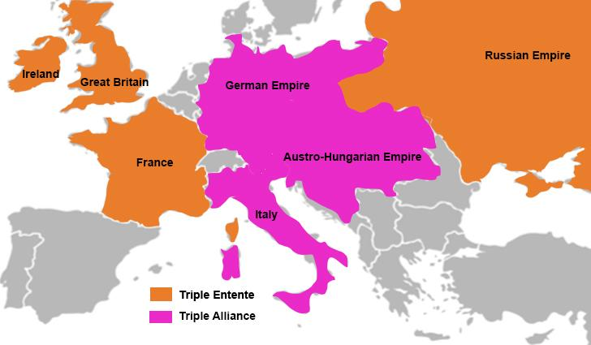
Title: The Long Fuse - Europe in 1914
LO: How did the political and social landscape of Europe in 1914 create tensions between European countries?
What were the main causes of WW1?
Key Enquiry Question: What were the causes of WW1, and how did different factors contribute to the outbreak of the conflict?
Remember the acronym MAINS:
M is for Militarism - The belief that a country should have strong armed forces and be ready to use them
A is for the Alliance System - Agreements between countries to support or protect each other
I is for Imperialism - When a country takes control of other countries to build an empire
N is for Nationalism - Strong pride / loyalty to a nation; it can also mean wanting people with a shared identity to form or rule their own country
S is for Significant Individuals - Important people whose choices or actions helped shape events leading to the First World War

Slide 4



Title: Friends and Foes - The Alliance System
LO: How did the formation of the Triple Entente and Triple Alliance increase the likelihood of war?
Key Terms:
Key Enquiry Question: What were the causes of WW1, and how did different factors contribute to the outbreak of the conflict?
Key Word |  | Definition
Alliance 동맹 联盟 |  | An agreement between countries to support and protect each other, especially during war.
Casualty 전사자 伤亡情况 |  | A person who is killed, injured, or goes missing during a war or accident.
Conquer 정복 征服 |  | To take control of a place or people by force, usually through fighting.

Slide 5
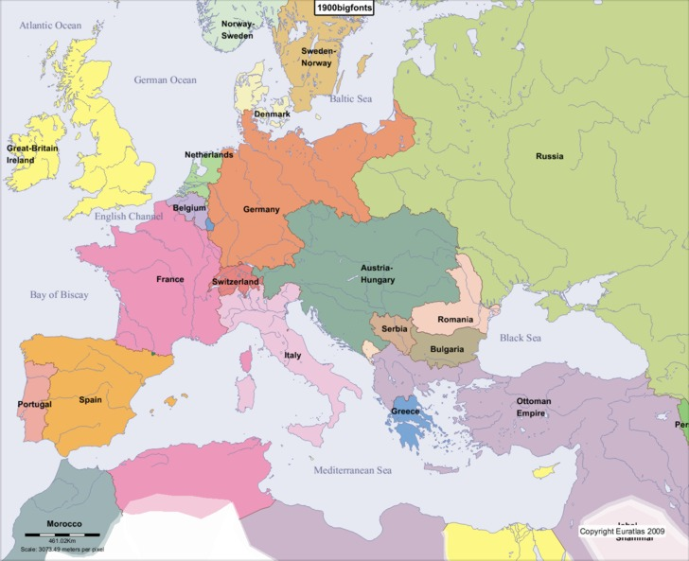
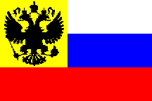
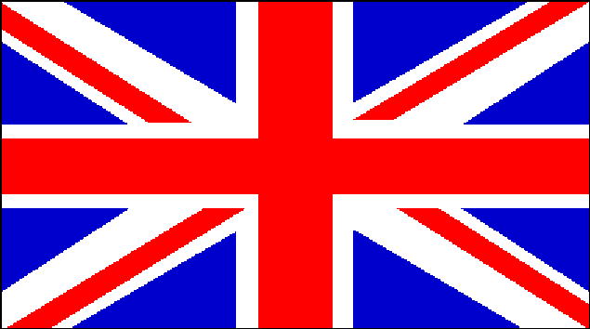




Title: Friends and Foes - The Alliance System
LO: How did the formation of the Triple Entente and Triple Alliance increase the likelihood of war?
The Great Powers:
In 1900, Europe contained the most powerful countries in the world and was dominated by six ‘Great Powers’: Britain, Germany, France, Austro-Hungary, Russia and Italy.
Each wanted to control as much of the world’s trade and become as wealthy as possible. This meant they were rivals.

Slide 6
Two sides (alliances) in 1914
Triple Alliance
Germany
Austria-Hungary Italy
Triple Entente
Britain
France
Russia
VS
All of these countries wanted different things and had different ideas about what might happen if a war broke out.

Slide 7
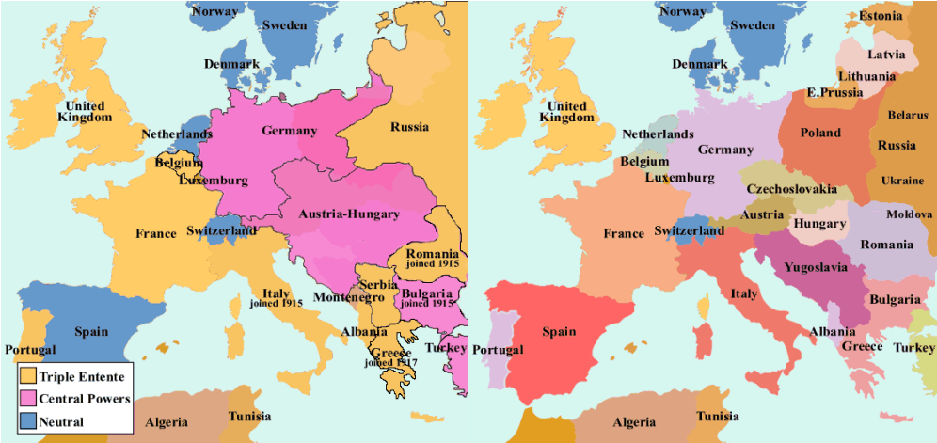

Slide 8
Title: Friends and Foes - The Alliance System
LO: How did the formation of the Triple Entente and Triple Alliance increase the likelihood of war?
The Alliance System: The Triple Alliance
Formed in 1882.
Germany, Austria-Hungary and Italy
Italy joined because they needed support after losing to France over North African territories.
The agreement was simple: If a war breaks out we fight together.
‘Scratch my back and I’ll scratch yours’
Mutual support to each member in the event of war or invasion, strengthening their security and cooperation.

Slide 9
Title: Friends and Foes - The Alliance System
LO: How did the formation of the Triple Entente and Triple Alliance increase the likelihood of war?
The Alliance System: The Triple Entente
Formed in 1907.
Russia, France, and Great Britain had been enemies.
However, Germany’s growing power and aggression threatened France and Britain, especially after Germany formed the Triple Alliance.
France and Russia formed an alliance, while Britain and France signed the Entente Cordiale.
Russia joined in 1907, creating the Triple Entente.

Slide 10
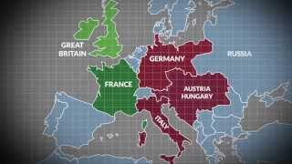
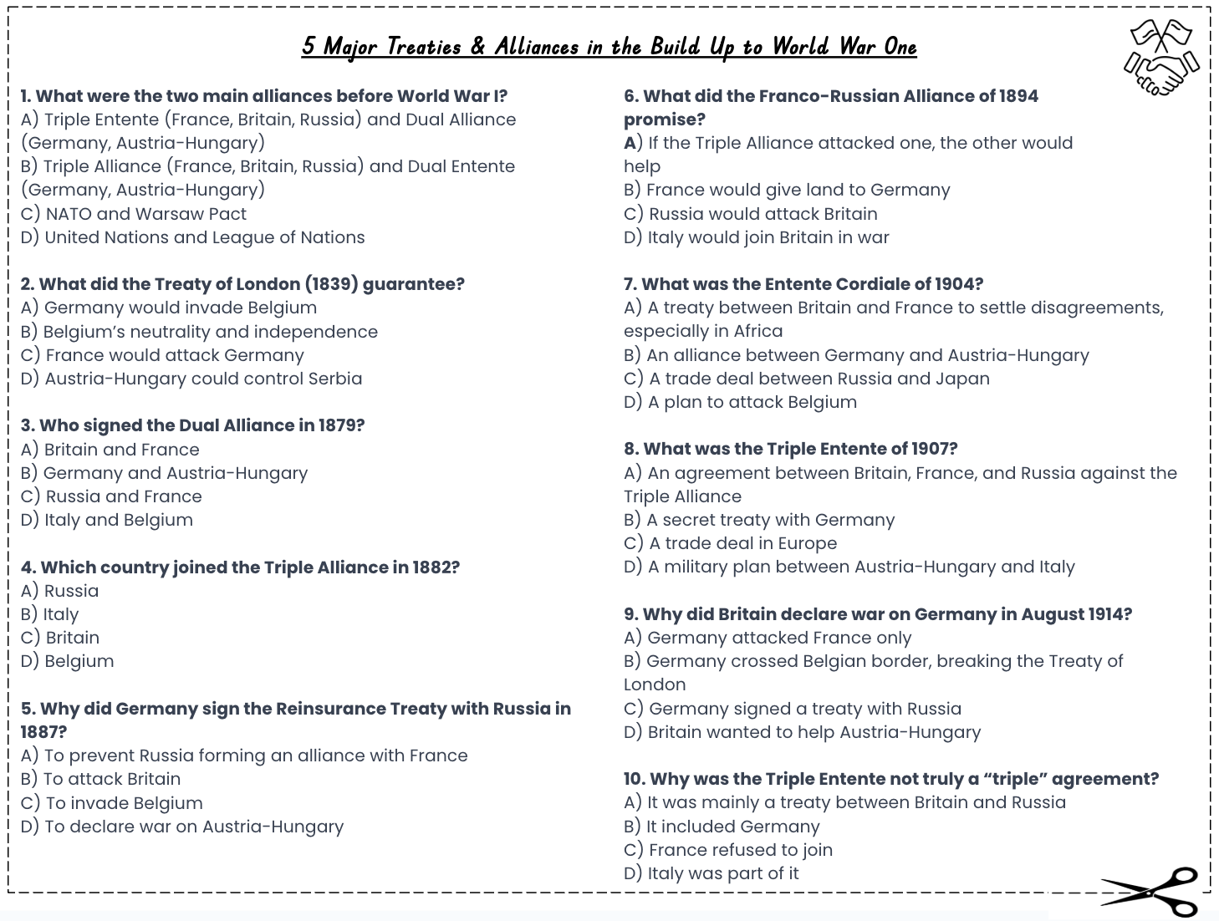
Title: Friends and Foes - The Alliance System
LO: How did the formation of the Triple Entente and Triple Alliance increase the likelihood of war?
The Alliance System:
Activity: Complete the multiple choice questions whilst watching the video on:
“ 5 Major Treaties & Alliances in the Build Up to World War One”
Notes:
https://www.youtube.com/watch?v=Wyg8CgKo7Do

Slide 11

Title: Friends and Foes - The Alliance System
LO: How did the formation of the Triple Entente and Triple Alliance increase the likelihood of war?
The Alliance System:
GREEN PEN YOUR ANSWERS
A) Triple Entente (France, Britain, Russia) and Dual Alliance (Germany, Austria-Hungary)
B) Belgium’s neutrality and independence
D) Germany and Austria-Hungary
B) Italy
A) To prevent Russia forming an alliance with France
C) If the Triple Alliance attacked one, the other would help
C) A treaty between Britain and France to settle disagreements, especially in Africa
A) An agreement between Britain, France, and Russia against the Triple Alliance
D) Germany crossed Belgian border, breaking the Treaty of London
A) It was mainly a treaty between Britain and Russia

Slide 12
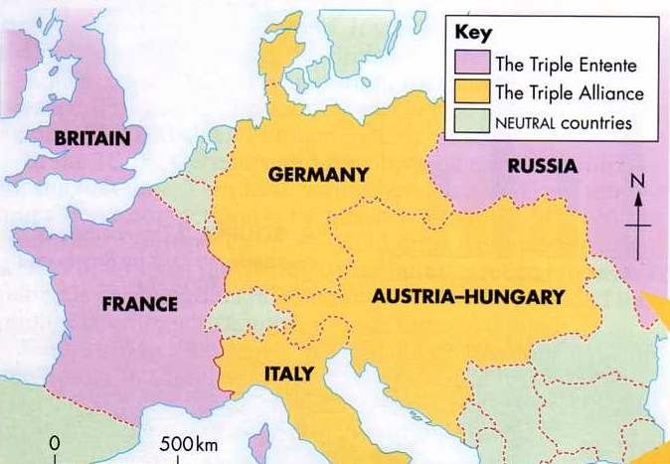
Title: Friends and Foes - The Alliance System
LO: How did the formation of the Triple Entente and Triple Alliance increase the likelihood of war?
Friends and Foes: European Aims in 1913:
European countries were growing more and more suspicious of each other.
Germany was jealous of Britain’s empire and wanted one of its own.
The Balkan countries, (Serbia, Bulgaria and Greece, S.E. Europe), had not yet joined any alliance. The Balkans were important because they were seen as a ‘trouble spot’ where different countries argued over land and power.
New weapons were being developed across Europe.
BALKANS
Tensions were rising, and the chance of war was becoming more likely.
The alliance system would decide which countries joined together if war began.

Slide 13

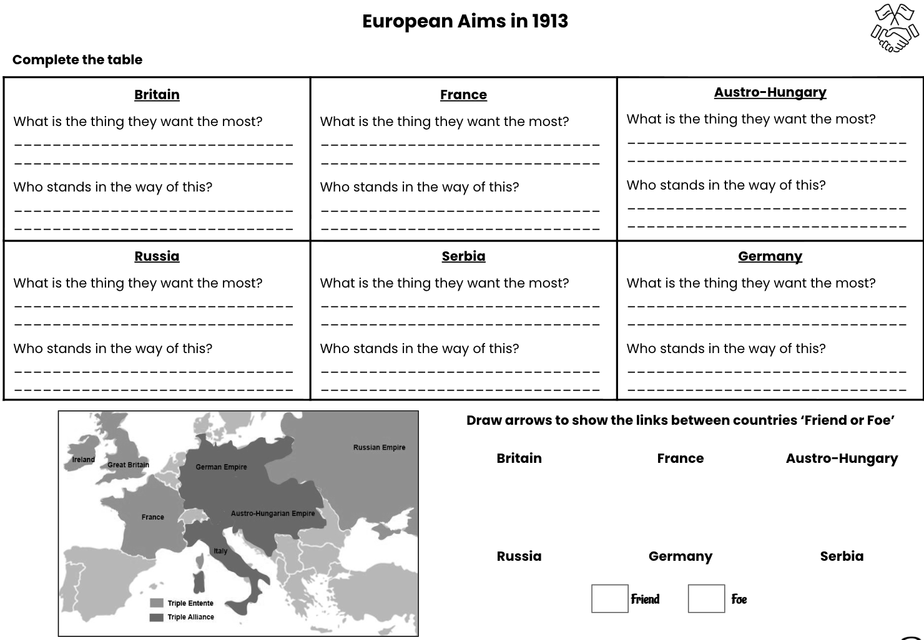

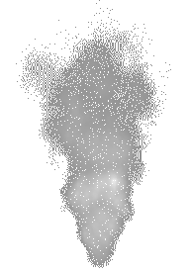



Title: Friends and Foes - The Alliance System
LO: How did the formation of the Triple Entente and Triple Alliance increase the likelihood of war?
Friends and Foes: European Aims in 1913
Activity: Use your resource sheet to read about six countries involved in the tensions of 1914.
For each country, fill in your table to show their main aims and worries.
Draw arrows to show the links between countries ‘Friend or Foe (enemy)’
Choose one country and explain in your own words why it was worried about the other countries. Use evidence from your table to support your answer
Choose two countries. Explain how their aims and worries could cause conflict and how this conflict could involve other countries. Use the links from your table to support your answer.
Notes:
https://www.youtube.com/watch?v=53_Ce7LZ0Nc

Slide 14
Title: Friends and Foes - The Alliance System
LO: How did the formation of the Triple Entente and Triple Alliance increase the likelihood of war?
Friends and Foes: European Aims in 1913
Green Pen!
Britain What is the thing they want the most? Keep their Empire/power Who stands in the way of this? Germany | France What is the thing they want the most? Area of Alsace and Lorraine back from Germany Who stands in the way of this? Germany
Austria-Hungary What is the thing they want the most? Land in the Balkan States Stability in their Empire Who stands in the way of this? Russia | Germany What is the thing they want the most? Bigger Empire Who stands in the way of this? Britain and France
Russia What is the thing they want the most? Strong Army Land in the Balkan States Who stands in the way of this? Germany and Austria-Hungary | Serbia What is the thing they want the most? Want to remain independent Want land in Bosnia (part of the Balkans) Who stands in the way of this? Austria-Hungary

Slide 15

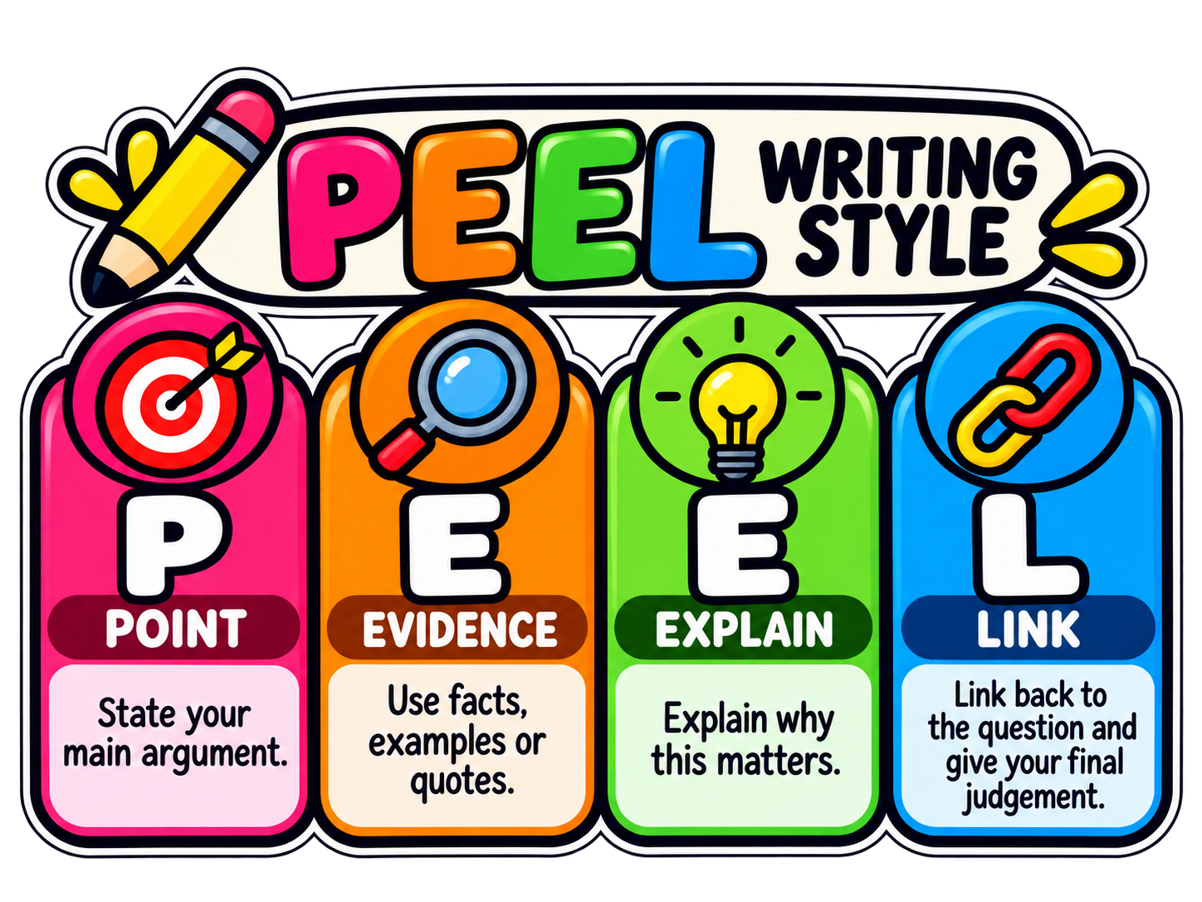
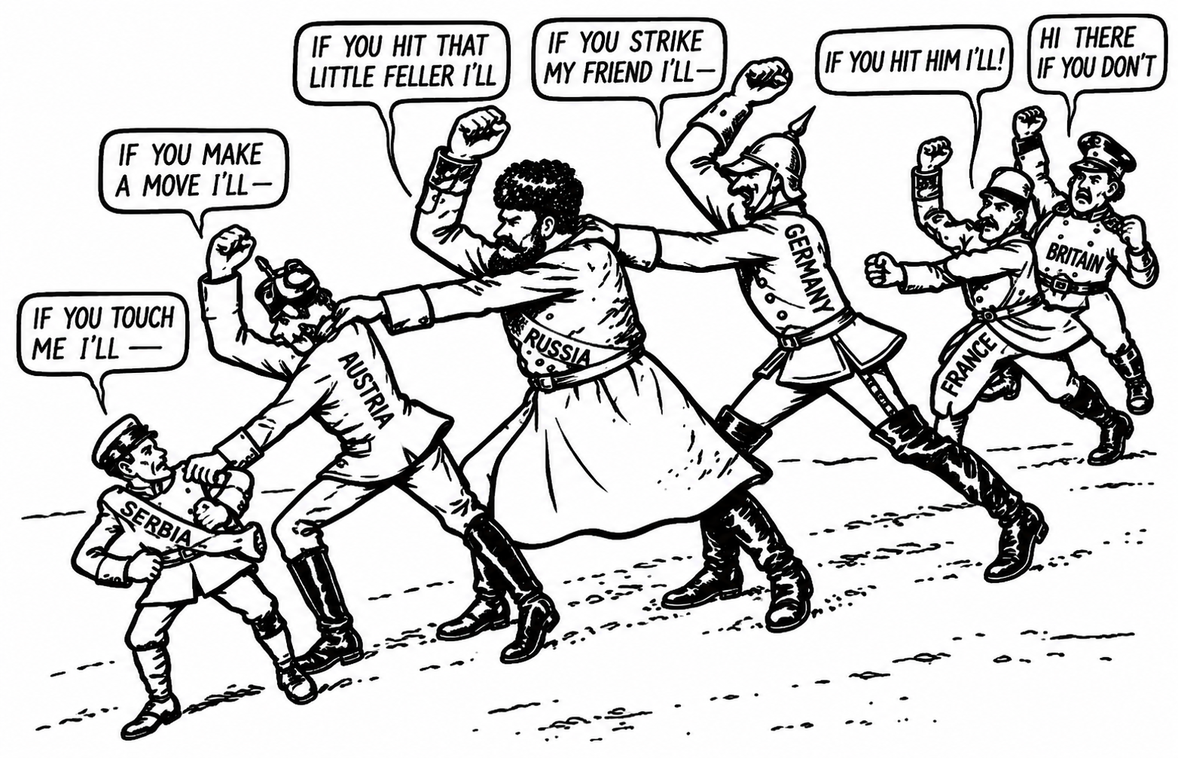

Title: Friends and Foes - The Alliance System
LO: How did the formation of the Triple Entente and Triple Alliance increase the likelihood of war?
Friends and Foes: European Aims in 1913
Activity: Explain how the alliances (Triple Entente and Triple Alliance) might have made war more likely.
In your book you should:
Briefly describe the two alliances.
Use evidence from the table of European Aims 1913.
Give your own opinion on whether the alliances helped cause WW1.
👉 You only need to write one short paragraph – time to practice PEEL as a quick summary of what you learned today.
What message is the cartoon giving about the alliance system in 1914? Explain your answer using evidence from the cartoon and what you have learned.
Notes:
https://www.youtube.com/watch?v=f4q7BqKw50c

Slide 16
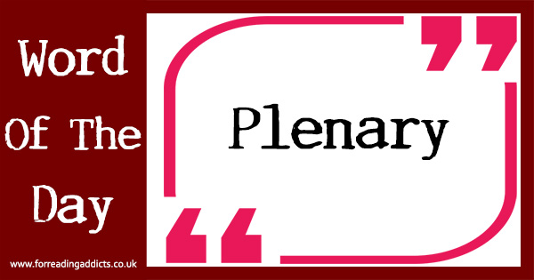
Title: Friends and Foes - The Alliance System
LO: How did the formation of the Triple Entente and Triple Alliance increase the likelihood of war?
Odd One Out
What was one main reason alliances made war more likely in 1914?
A) They helped countries trust each other more
B) They turned small problems into bigger wars by pulling in more countries
C) They stopped leaders from building armies
D) They made everyone agree on peace
“What can we learn from this about how small problems can grow bigger in our own lives?”
Notes:
https://dashboard.blooket.com/set/68b116266e3af35fc52bd327

Slide 17
Title: Friends and Foes - The Alliance System
LO: How did the formation of the Triple Entente and Triple Alliance increase the likelihood of war?
Odd One Out
How might countries have shown respect or fairness to avoid war?
A) By refusing to talk to their rivals
B) By using violence first
C) By solving problems through fair talks and diplomacy
D) By ignoring smaller nations like Belgium
“How could this idea guide the way we treat others every day?”
Notes:
https://dashboard.blooket.com/set/68b116266e3af35fc52bd327

Slide 18
Title: Friends and Foes - The Alliance System
LO: How did the formation of the Triple Entente and Triple Alliance increase the likelihood of war?
Odd One Out
If you were a leader in 1914, how would you act with honesty and responsibility to keep peace?
A) Keep secret promises and surprise attacks
B) Work openly with other leaders to avoid war
C) Refuse to listen to other countries’ worries
D) Use threats instead of discussion
“In what ways might honesty help us in school or at home?”
Notes:
https://dashboard.blooket.com/set/68b116266e3af35fc52bd327

Slide 19

Title: Friends and Foes - The Alliance System
LO: How did the formation of the Triple Entente and Triple Alliance increase the likelihood of war?
Odd One Out
Why is honesty important when countries make alliances?
A) It helps countries know they can rely on each other
B) It makes war more exciting
C) It allows leaders to keep secret plans
D) It means countries can break promises more easily
“Why is it important to be honest so others can rely on us?”
Notes:
https://dashboard.blooket.com/set/68b116266e3af35fc52bd327

